Slide 1
Data Analytics

Slide 2
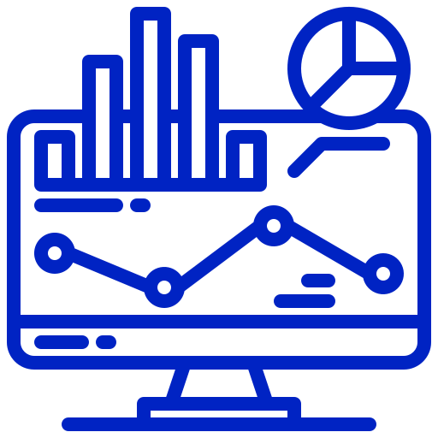
Infomineo has a unique approach to Data Analytics
Analytics
Traditional model
Infomineo model
Most Data Analytics companies provide standard models that they transpose from a client to another. Such models very often remain at Proof-Of-Concept stage, as integration with IT systems is not completed
Most Data Analytics providers are specialized in Data Visualization tools, e.g. Tableau, Power BI, etc.
Most providers work on a project basis – After project completion, the models can be hard for clients to maintain over time
Some providers retain rights on the Intellectual Property they generate
We are problem solvers, we need to understand your question or challenge and will find the data and models that answer your questions. The output is co-constructed with our client and not a model taken off the shelf
We have a multi capabilities team that can provide you an end-to-end approach from cleaning the data to visualizing the model output
We work on a retainer basis, we are an extension of your team, and make it easy to work with us, which 1/minimizes the time you spend on paperwork and 2/allows you to work with us on an iterative basis
The output of our work will become a knowledge asset of our client, who will hold the Intellectual Property of it

Slide 3




Infomineo offers a full suite of Data Analytics Services
Analytics
Three Levels of Analytics
Business Oriented Approach
Three Types of Data Support
Acquire & Prepare
Unleash the power of Information : discover, assess, clean, and transform Data from multiple sources with ease.
Data Cleaning
Data Exploration
Statistical Analysis
Data Visualization
Infomineo’s teams demonstrate a high Business sense
Data
Analysis
We work in an iterative approach to fulfill clients needs quickly
Business & Data Understanding
Analyze
Empower your business with dynamic insights with unified Self-Service Analytics.
Tackle critical business challenges using cutting-edge models to tackle critical business challenges.
Model building & tuning
Model evaluation & retraining
Data
Science
Agile Methodology
Delivery Management
Data Sourcing & Integration
Feature Engineering & Data transformation
Model Deployment & scalability
Deploy
Bringing Models to Life
seamless deployment, monitoring, and integration into client's infrastructure for maximum impact.
Data Engineering
Release & Change Management are handled: versioning, unit tests, model validation, documentation…

Slide 4
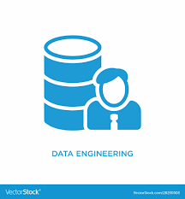


Infomineo team provides a complete solution for your data needs
Acquire & Prepare
Unleash the power of Information, discover, Assess, Clean, and Transform Data from multiple sources with ease.
Capabilities
Data Sources
Integration
Storage
Preparation
DE
Analyze
Empower your business with dynamic insights with unified Self-Service Analytics.
Tackle critical business challenges using cutting-edge models to tackle critical business challenges.
Data Sources
Integration
Storage
Preparation
Exploration
Visualization
DE
DA
Data Sources
Integration
Storage
Preparation
Exploration
Visualization
Modeling
DE
DA
DS
Deploy
Bringing Models to Life: seamless deployment, monitoring, and integration into client's infrastructure for maximum impact.
Data Sources
Integration
Storage
Preparation
Exploration
Visualization
Modeling
Deployment
DE
DA
DS
DE : Data Engineering, DA : Data Analysis, DS: Data Science

Slide 5




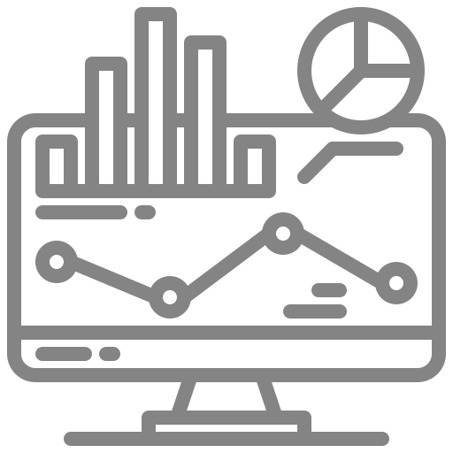


Infomineo approach to helping you
Analytics
Intake
Execution
Delivery
Understanding client needs and objective
Get a deep understanding of the client objectives:
Business questions to answer
Assess available data, data needs if any, critical data elements to take care of
Planned use of the analytics outputs
Structuring approach
Define the best data analytics strategy to answer the client’s business objective
Estimate the time and type of analytics support needed
Agree on the desired type of output
Executing your
Data Analytics projects
Leveraging a full range of analytics capabilities
2. Analyze
Explore & Visualize
Descriptive analysis
Identification of KPIs
Reporting, Dashboards
“Story-telling”
Modeling
Algorithms to answer business question
Evaluation and validation of the algorithm
Deriving insights
Performing in-depth quality assurance
Analyzing data outputs to derive insights in line with the initial client ask
Handover
Presenting the approach, results and potential limitations
Sharing all documentation and codes
Getting client feedback
Business & Data Under
standing
Agile Metho
dology
Delivery Management
1. Acquire & Prepare
Identifying Data Sources
Extracting and Transferring Data
Metadata & Dictionaries
Merging of various data sources / Adding new data
Assessing Data Quality, handling outliers
Restructuring Data for analysis
3. Deploy
Integrating models and scaling with clients’ IT Teams
Performing regular model maintenance

Slide 6


Infomineo can handle all steps of a Data Use Case
Analytics
ACQUIRE & PREPARE
ANALYZE
DEPLOY
Data Sources
Integration
Storage
Preparation
Exploration
Visualization
Modeling
Delivery
ERP
Warehousing
Environment
Statistics
Prescriptive Analytics
Recommendation Systems
Model Monitoring
Batch Data Integration
Data Quality
Time series
Predictive Analytics
DS/ML Platforms
CRM
Feature Engineering
Segmentation
NOSQL Environment
Simulation
and Optimization
Version Control
Databases
Stream Ingestion Real time
Data Cleaning
Reports
Machine Learning
Orchestration
Speech Analytics
Big Data/Distributed Environment
Deep Learning
Video/Image Analytics
Security
External Sources
Dashboard
Text Analytics
Message Broker
Data Transformation
Graph Analytics
Containerization
Sentiment/ Behavior Analytics
Files
Cloud
Environment
Real time Reporting
Geospatial and
Location Analytics
Interfacing

Slide 7

Examples of potential uses cases
Research
ACQUIRE & PREPARE
ANALYZE
Tourist data
Information on the number of tourists visiting a destination, their demographics, travel patterns, and spending habits, sentimental comments.
Destination data
Data on the attractions, accommodations, and infrastructure available in a destination, including information on capacity and utilization.
Economic data
Data on the economic impact of tourism, including revenue generated by the tourism industry, employment, and other relevant indicators.
Environmental data
Data on the environmental impact of tourism, including information on energy consumption, waste generation, and other environmental indicators.
Visualize and monitor tourist activities in a destination through the creation of dynamic and interactive reports and dashboards that incorporate a comprehensive, multifaceted analysis such as
Destination : visitor numbers, spending habits, demographic information, and satisfaction levels.
Resource allocation & management : availability of hotel rooms, transportation options, and tourist activities.
Optimize revenue management by identifying the key drivers of revenue (ex: visitor numbers, spending patterns, and pricing strategies) and develop pricing strategies that maximize revenue (ex: considering seasonality, incorporating discounts or promotions…).
Forecast of future demand for tourist destinations by analyzing data on historical demand trends, weather patterns, and other relevant factors to develop a model that predicts future demand for a particular destination.
Improve the tourism experience by using text analysis and sentiment analysis techniques to extract meaningful insights from these data and understand the factors that contribute to tourist satisfaction

Slide 8
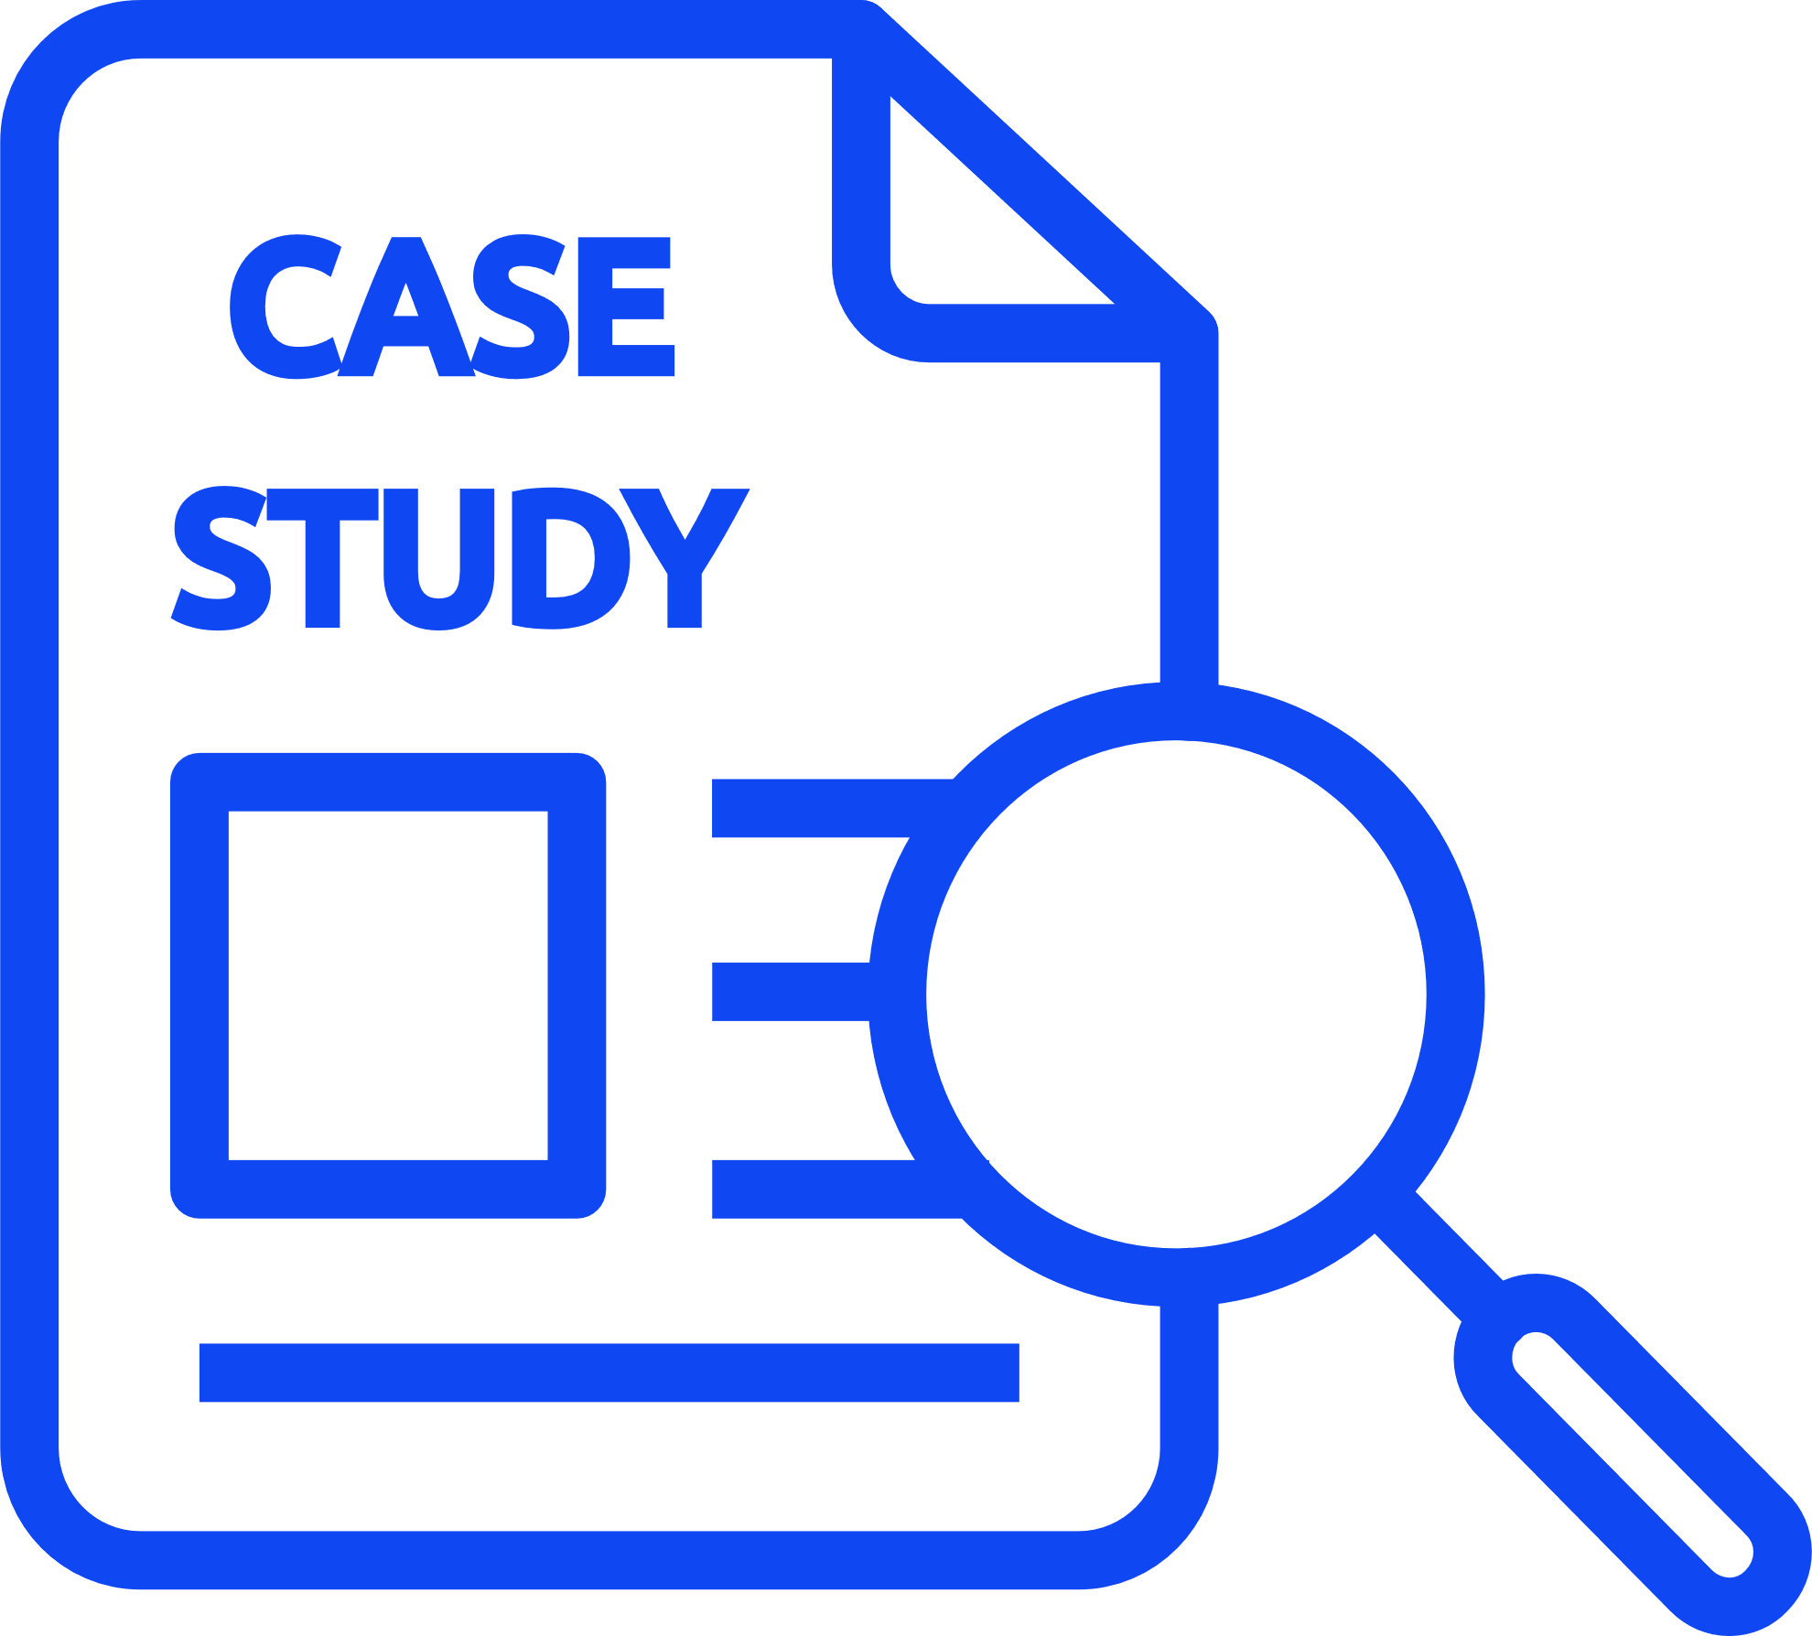


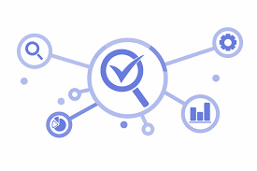





CASE STUDY
Client Challenge
Our Solution
Outcome
Client:
The client wants to have an automatized Human Resource Dashboard to track, analyze and report on HR KPIs.
The firm was looking for:
The company decided to use Infomineo’s Data Analytics service as a solution to cover:
The firm recognized that the quality of the Data Analytics service provided a useful reporting tool resulting in:
A multinational firm
Data Quality & Consistency problems between the various Data sources
Dashboard creation that reflects HR Team needs
During the project, Data were corrected in the ERPs :
Manual files where not used anymore
Data Quality improved by 55% for critical data elements
Effective and quick solution
“I was really impressed by the responsiveness of the team : they came up with a first and quite impressive dashboard proposition within only a couple of days. I also really appreciated the quality of the work; it was really helpful for us to identify the data cleansing needed in our ERP.”
─ Chief Human Capital Officer (Client)
Estimated 1 FTE from the HR department could be reallocated to other tasks
Helped the company to start its Data Transformation
Infomineo has been asked to work with client’s Finance Team to create another dashboard
Smooth integration with its existing ERPs
Lower cost than buying from a specialized company an HR Dashboard tool
Ad-hoc deliverables :
Dictionaries, Creation of Metadata, Data Quality on boarding

Slide 9





Why work with us
Analytics
Combination of Data Analytics and Data Research methodologies
Opportunity to work with a unique professional network
Top-class InfoSec credentials - ISO certified & RGPD Compliance
World class Data Analytics capabilities
Management of specific day-to-day tasks or full end-to-end projects
Continued support in the long run to maintain and adjust solutions
Full compliance with confidentiality and ethics best practices
Adaptability
Multinational, multi-skilled teams allowing you to access top talents across different geographies
Retained model granting maximum flexibility to scale up when needed
Flexibility and scalability
Brainshoring approach: high quality support, critical thinking and business sense…
…provided to our clients from our nearshore locations: Casablanca, Mexico and Cairo
Retainer model granting full dedication to clients and most cost-effective daily/hourly rate
Value added services at a competitive price

